Slide 1

E-Commerce Website
Task - 2

Slide 2
E – Commerce Website
E-com is buying and selling of goods & services , over an electronic network, primarily the internet .
LMS Username | Name | Batch
2115a422 | JAYANTHINATHAN V | A4
2115a44 | ALLEN ROSHAN R | A4
2115a41 | ABDUL LATIF R | A4
2115a444 | SABAREESHWARAN M | A4

Slide 3
E-Commerce Website
An e-commerce website or app is one of the best full-stack development projects you can practice at the advanced level. It is a vast project involving front and back-end technologies and database knowledge for efficient execution and implementation. The project takes time and effort because you must maintain a huge database with multiple product categories and prices.

Slide 4
Task - 2
Create various Front End Programs
Draw and design a uniform front end code for calculator
Draw and design a interactive front end code for text-editor
Evaluation Metric:
100% Completion of the above tasks
Learning Outcome
Get to know about concepts of project bucketing
Knowing about various frontend development framework like angular, vue,react
Know about various react topics like components, props, state, life cycle etc.

Slide 5
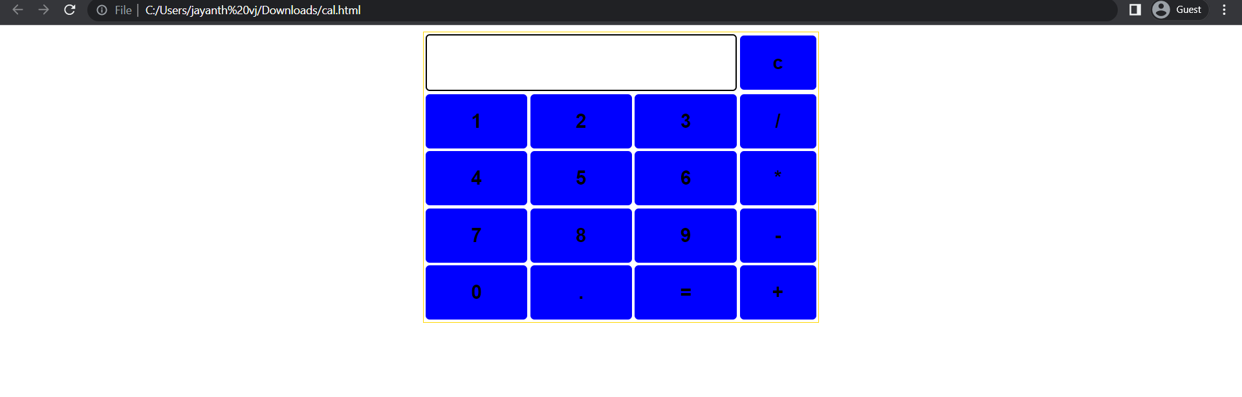
Past calculator output here

Slide 6
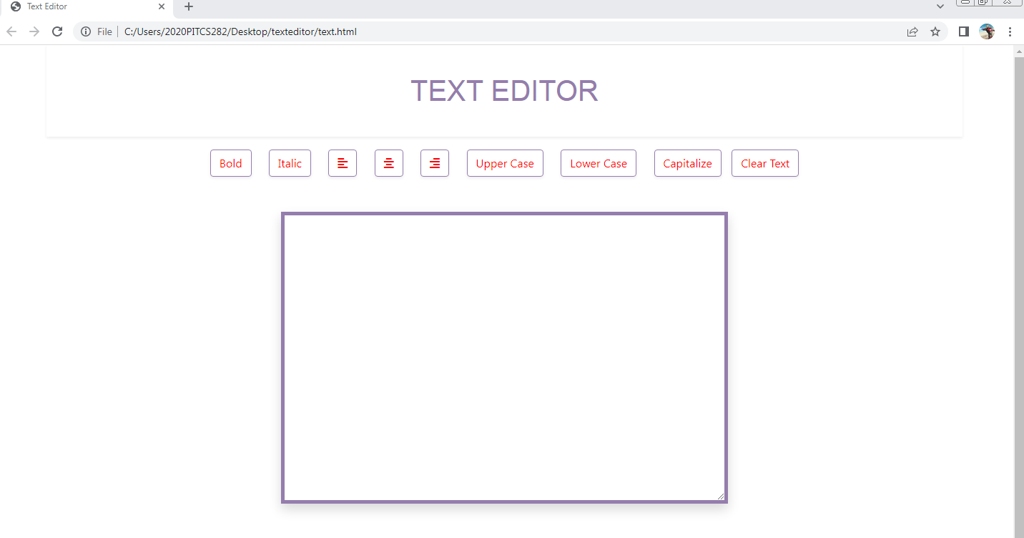
Past text editor output here

Slide 7
Assessment Parameter
Setup Project for Calculator project
Setup basic structure of text-editor project
Create a main component with the outer structure of calculator
Check-List
Create main component with all feature buttons
Create a button component with on click handler
Create a json object to store data for text editor
Create a ` evaluateExpresion` function to evaluate value
Push both code to github

Slide 8
E-Commerce Github
https://github.com/Jayanthinathan02/jayanthinathan_02

